Slide 1
Marketing Campaign Analysis
Company X recently launched a social media marketing campaign across multiple platforms. The primary objectives were to boost customer engagement, drive revenue growth, and enhance brand and product visibility. After running the campaign for several months, they aim to assess its overall performance.

Slide 2
Objective
The objective of this analysis is to understand:
The level of engagement across various platforms.
The impact of the campaign on revenue growth.
The effectiveness of the campaign in enhancing brand and product visibility.

Slide 3
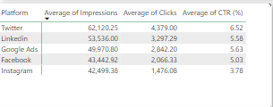
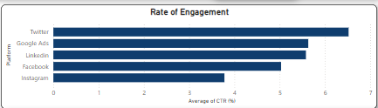
Engagement across social platforms
Twitter achieved the highest click-through rate (CTR) of 6.52%,
LinkedIn followed with a CTR of 5.58%, demonstrating an effective professional audience.
Google Ads delivered a CTR of 5.63%, showcasing reliable engagement levels for paid search campaigns.
Facebook recorded a CTR of 5.03%, indicative of moderate engagement within the audience.
Instagram while generating over 42,000 impressions, had the lowest CTR of 3.78%, suggesting potential areas for optimization to enhance interaction.

Slide 4
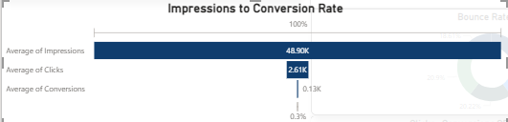
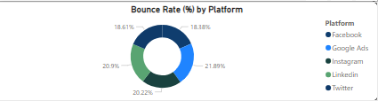
Impact of campaign
The campaign achieved an average of 48,900 impressions across all platforms. This resulted in an average click-through rate of 2,610 clicks (5%), ultimately generating 130 customer conversions, equating to a conversion rate of 0.3% of the total impressions. These highlight the performance of the campaign in terms of visibility, audience engagement, and the proportion of leads converted into customers.
The bounce rate represents the percentage of visitors who engaged with the landing page but did not proceed further. Facebook: 18.16%
Google Ads: 20.22%
Instagram: 21.89%
LinkedIn: 23.99%
Twitter: 18.83%

Slide 5
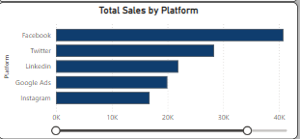
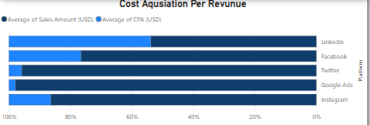
Revenue by Platform
Facebook leads in total sales, showcasing its strength in converting impressions to revenue.
Instagram and Twitter lag in sales performance despite generating significant impressions, highlighting potential inefficiencies in turning engagement into conversions.
Platforms with higher CTRs and sales, such as Facebook and Twitter, appear to offer better cost efficiency.
Instagram, with lower engagement and sales, may require a reevaluation of budget allocation to improve ROI.

Slide 6
Recommendation
Leverage Facebook for Sales Campaigns: Strengthen the sales and invest resources here for sales-driven campaigns.
Use Twitter for Brand Awareness: Focus on creating engaging content to maintain Twitter’s strong audience interaction.
Optimize LinkedIn for Corporate Engagement: Develop targeted campaigns tailored for professionals and businesses.
Instagram’s Role: Reevaluate Instagram’s fit for the target audience or adjust the content strategy to appeal to its visually driven and younger user base.
Segment Products by Platform Demographics:
Facebook for older or family-oriented audiences.
Twitter for younger, tech-savvy, and engagement-driven users.
LinkedIn for corporate and professional products or services.
Instagram for visually appealing products targeting younger demographics.

Slide 7
Conclusion
Facebook demonstrates the highest potential for converting impressions into paying customers. This success may be influenced by an effective sales team and a strong alignment with its target audience.
Twitter excels in driving brand awareness with its high engagement rate, though it generates less revenue compared to Facebook.
LinkedIn shows potential for engaging corporate clients but requires optimization to reduce bounce rates and improve user interaction.
Instagram underperforms in terms of engagement and conversions, possibly due to a misalignment with the campaign’s target audience or content strategy.

